Slide 1
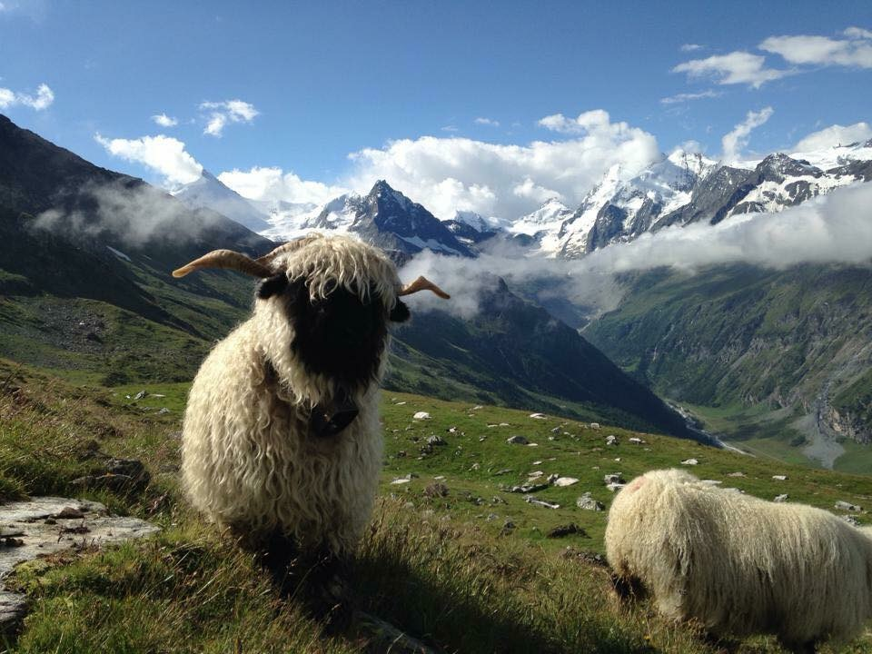
Get Show Ready! Washing Your Valais Blacknose TIPS
Notes:
Getting Show Ready! Washing Your Valais Blacknose - TIPS

Slide 2
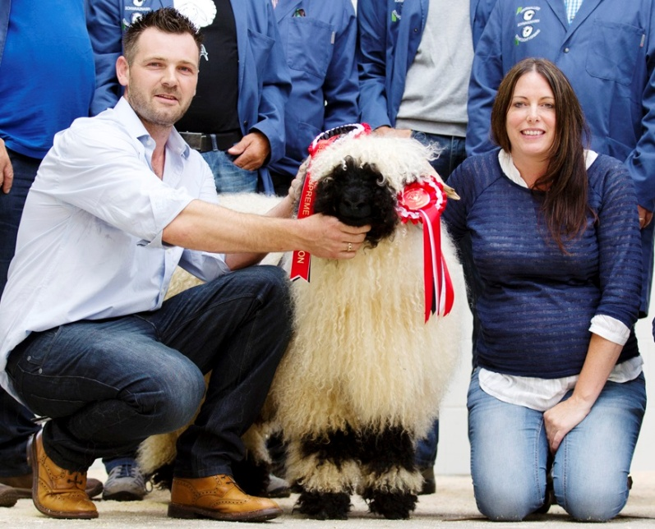
What Are You Aiming For?
Fleece staple length should be about 10 cm (5-6 months growth – sheep
should be shorn twice yearly)
Wool should be natural, even and balanced out over the whole body, including
the head and legs
Fleece should be white and clean
Docked tails must be in line with the top of the black markings on hocks

Slide 3
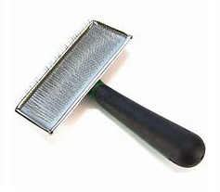
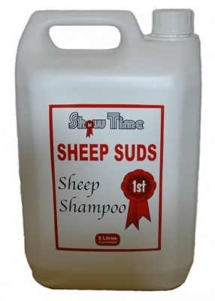
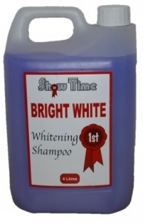
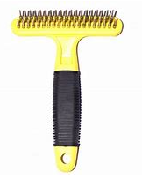
Useful Products & Implements
Fairy liquid helps to ease
out stubborn knots
Slicker, soft-pin and T-Shaped
grooming brushes are helpful for knots
around the head and legs
Examples of various shampoos above.
Can be found in any local agriculture stores or online
http://www.showtime-supplies.co.uk/

Slide 4
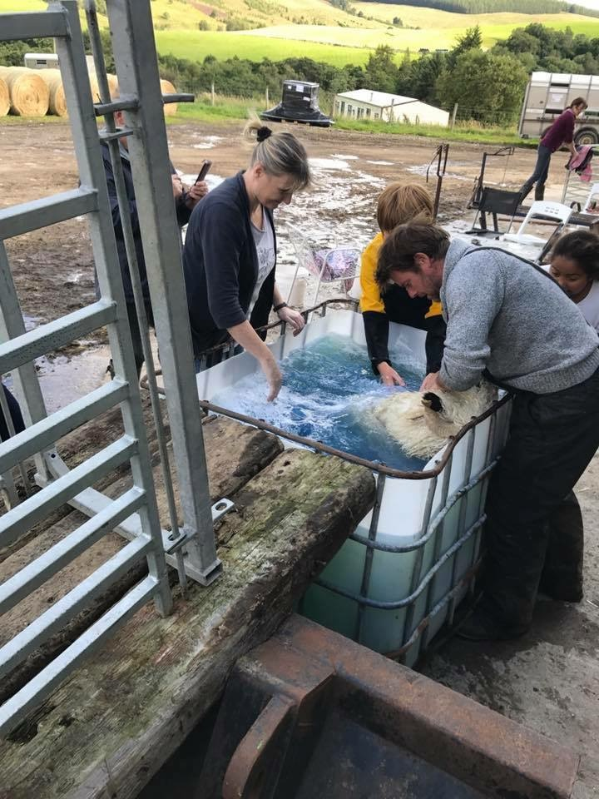
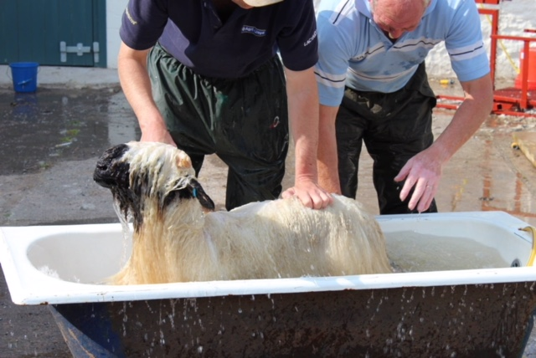
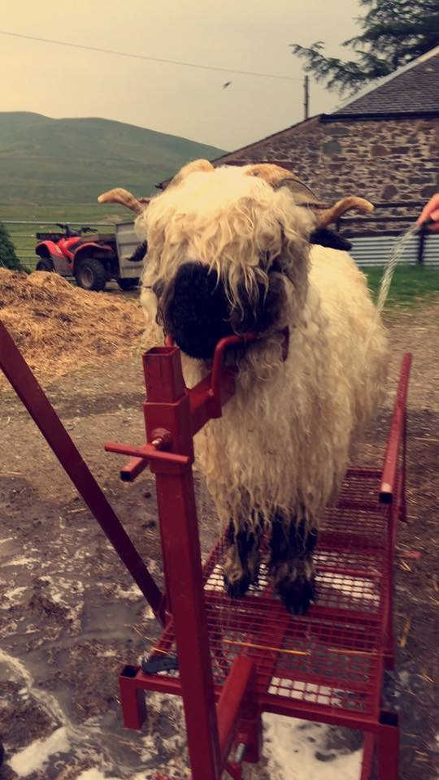
Recommended Items
Extra large plastic container (e.g cut down IBC) or bath tub
Dressing Stand
Buckets, the more the merrier
Helpers, lots of them
Notes:
Show Prep – What Do You Need?
Wash only once – overwashing affects the wool
Try and remove matts with soapy water and brushing them out
Useful implements, i.e. brushes?

Slide 5
Wet the head with warm water, using soapy liquid to tease and brush out any knots. Rinse clean. Repeat same process with the legs. This is best done using a dressing stand and can save your back a little. If you don’t have a stand, make a small pen with gates or tie up the sheep somewhere that is easy for you work.
Wash the sheep in a large container or bath of warm water and shampoo which you have chosen. Rinse/dip clean. If you don’t have a large container/bath you can use the dressing stand with buckets/hose for washing and rinsing. Or again in a small pen or tied up.
After washing and rinsing – do not brush the fleece. Allow the sheep to dry naturally to achieve best in the natural crimp. The wool is one of the categories in which the sheep are graded. If the fleece is brushed and the natural crimp lost, you can lose points in this area when being graded.
You can use a blower to help speed up drying time. Be careful not to get the fluffy look and keep the crimp defined.

Slide 6
Washing is hard work!
How to get it done quicker?!
Bribe as many friends and family you can find ☺

